Slide 1
Designing a PID controller using analog input and analog output signals using digital and analog components for laboratory use
Pranabendra Prasad Chandra
001610801122

Slide 2
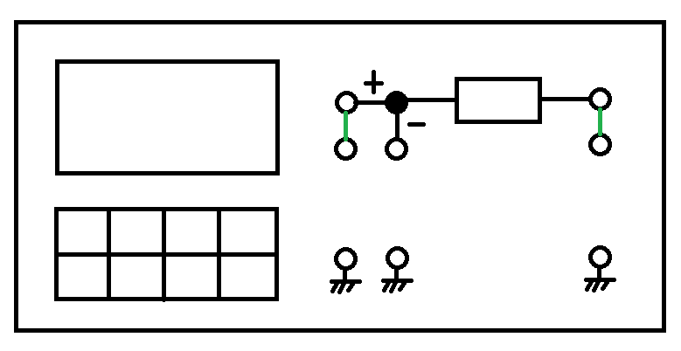
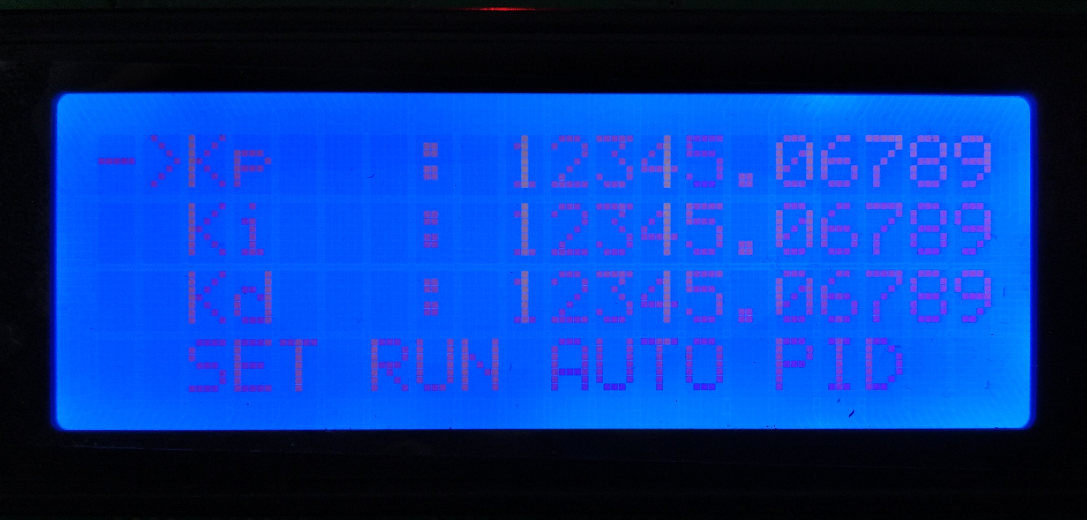
Top View of the Controller
SET
POINT
CONTROLLER
TO PLANT
SCOPE
FEEDBACK
SCOPE

Slide 3
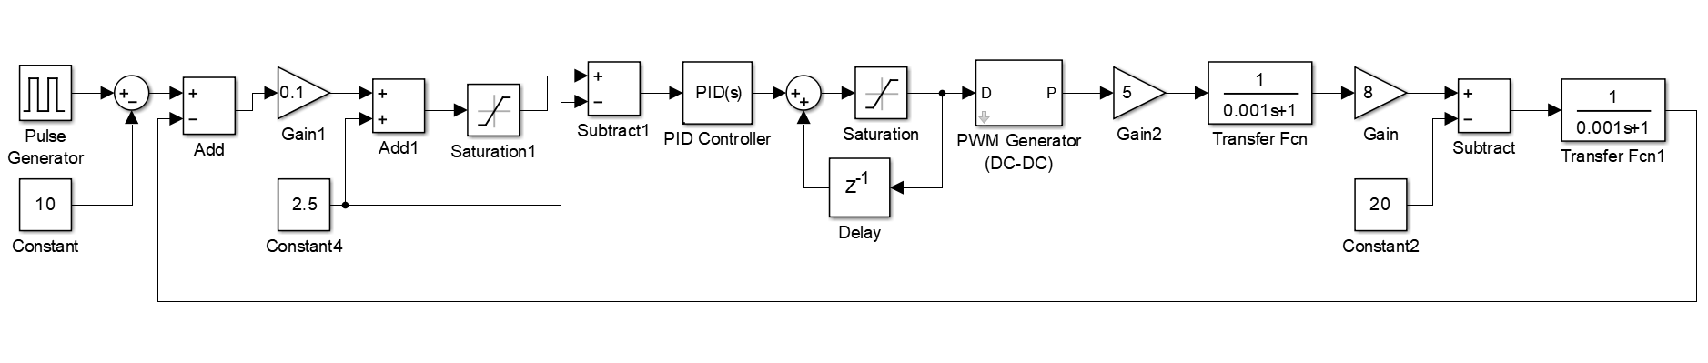
Block diagram of digital PID in hardware

Slide 4
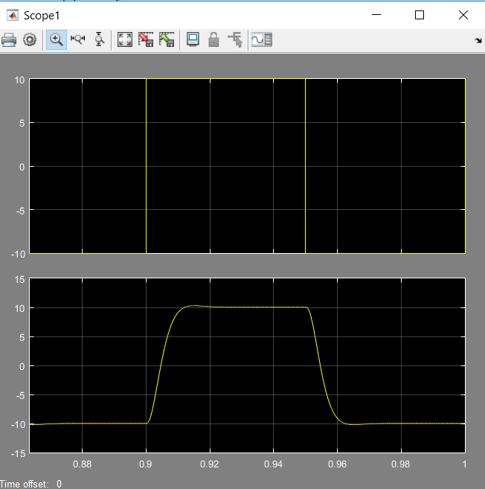
Simulation Result

Slide 5
Block diagram of digital PID in hardware

Slide 6
Block diagram of digital PID in hardware
Signal Generator – 10 Vp-p (max)
Sine Square Triangle

Slide 7
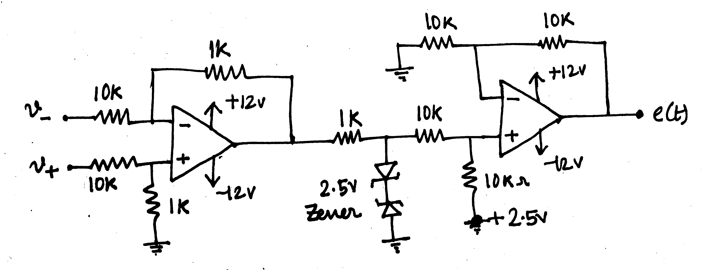
Block diagram of digital PID in hardware
V- : 10 Vp-p
V+ : 10 Vp-p
e(t) : 0-5V
Op amp : OP07
2.5V Zener : 1N5222B

Slide 8
Block diagram of digital PID in hardware
5V PWM
20x4 LCD
Keypad
Microcontroller : Arduino Mega
Voltage Input : 5V Regulated DC
Sampling Frequency : 5000 Hz (max 9 kHz)
PWM Switching Frequency : 5000 Hz

Slide 9
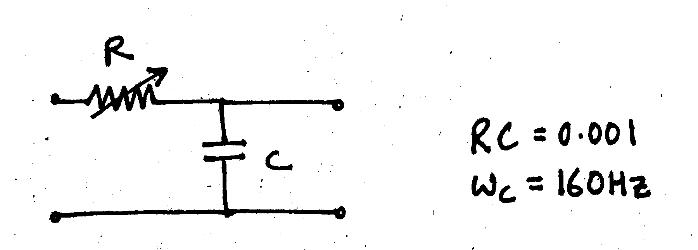
Block diagram of digital PID in hardware
Low Pass Filter
Cut-off frequency should be less than the switching frequency
But, cut-off frequency should be high enough to pass the setpoint
Here, cut-off frequency is 160 Hz (tuneable)

Slide 10
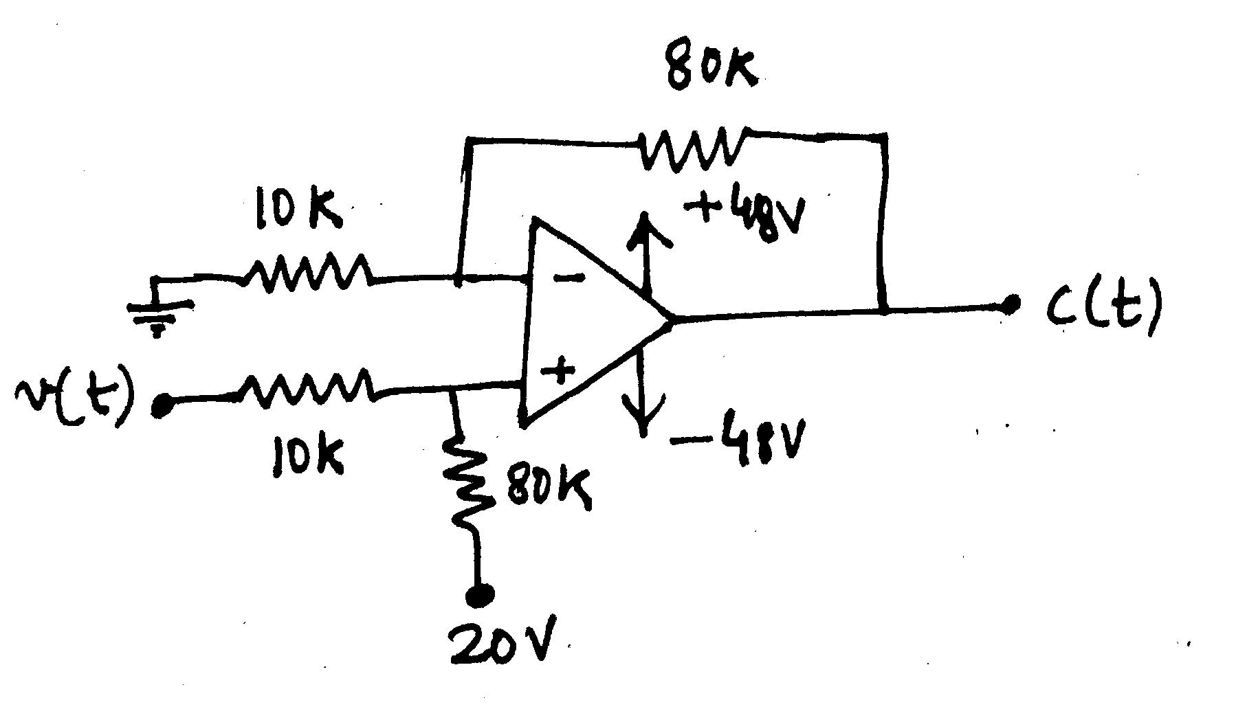
Block diagram of digital PID in hardware

Slide 11
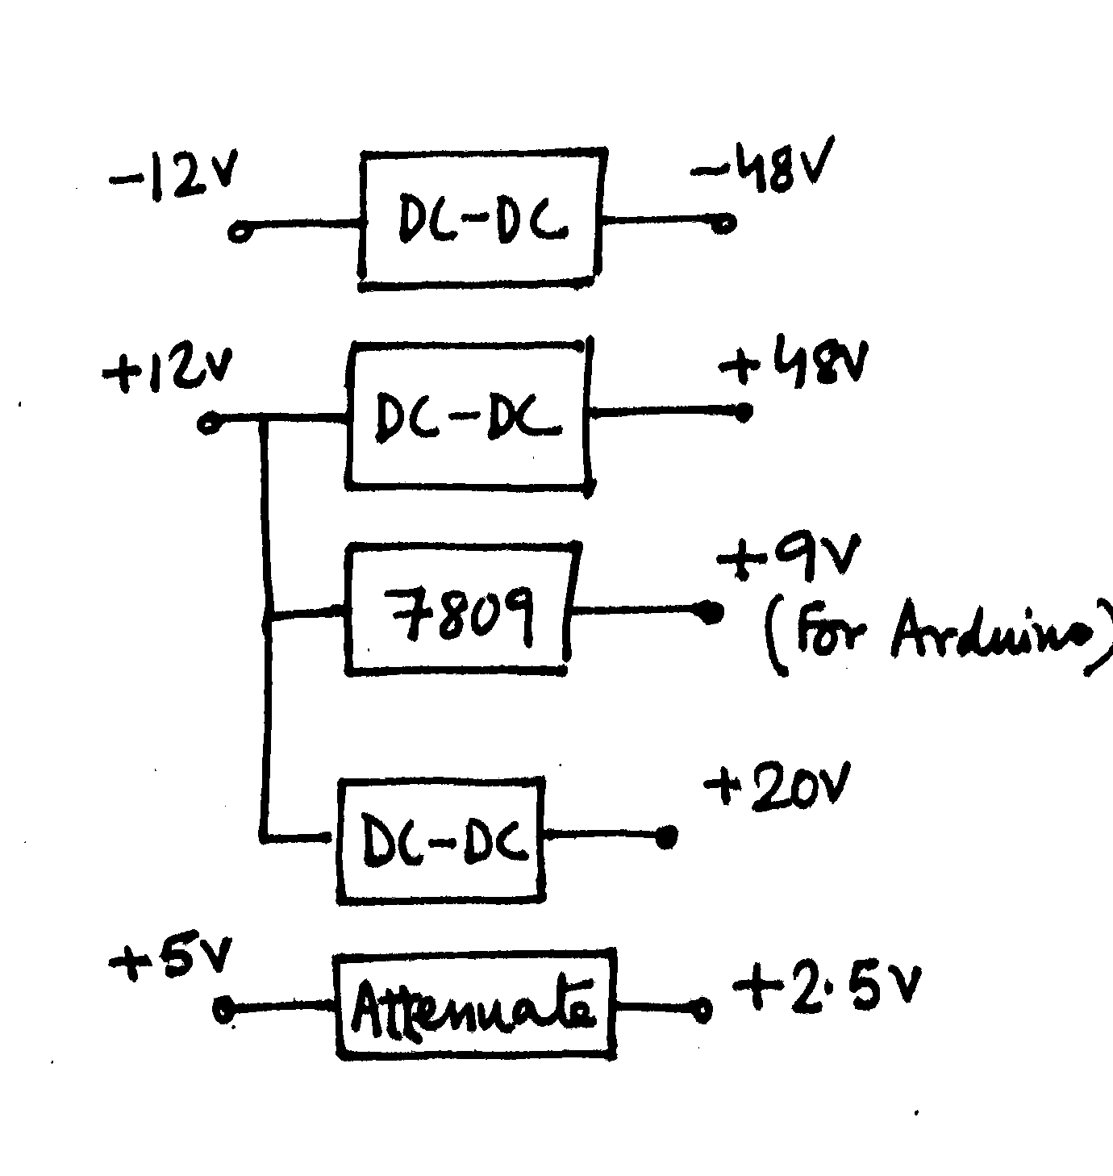
Power Lines

Slide 12
Protection
Risk
Remedy
Chance of pressing multiple buttons together
Shorting the output
Putting input signal in output port
Overvoltage in mains
Overcurrent from mains
Latching the first button pressed
Current limiting resistor
Buffer
P.T. + Relay
C.T. + Relay

Slide 14
References
Secrets of Arduino PWM (Link)
Basic Calculation of an Inverting Buck-Boost Power Stage – Texas Instruments (Link)

